Slide 1



G₂P₂S Navigating AMR using multi-modal data analysis Recommendation System for Antibiotic Treatment
Instructors - Prof. Jacob Moran-Gilad, Dr. Daniel Grupel & Mr. Amit Weiss
Client - Prof. Jacob Moran-Gilad
Ben Gurion University of the Negev Beer Sheva, Israel
Notes:
AMR - Antimicrobial resistance

Slide 2


Project Members
Faculty of Health Sciences
Prof. Jacob Moran-Gilad
Dr. Daniel Grupel
SISE
Mr. Amit Weiss
Students
Gal Agasi ,Guy Zaidman
Tomer Kelner, Tomer Varon

Slide 3
Introduction
Decision process for optimal antibiotic treatment is a complex process which takes into account several aspects
Requires knowledge about the clinical scenario, patient factors and pharmacological factors
In an effort to streamline the process and provide a solution to problems which arise from it, we have developed an End-to-End Decision-Support System for antibiotic treatment
Performs a real-time recommendation process
Main target audience - medical staff in hospitals
Notes:
גל

Slide 4


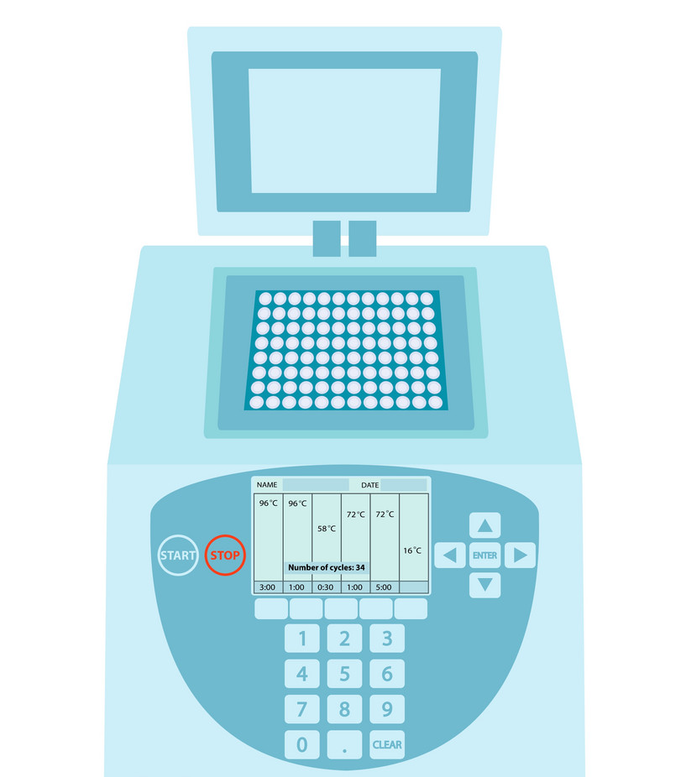
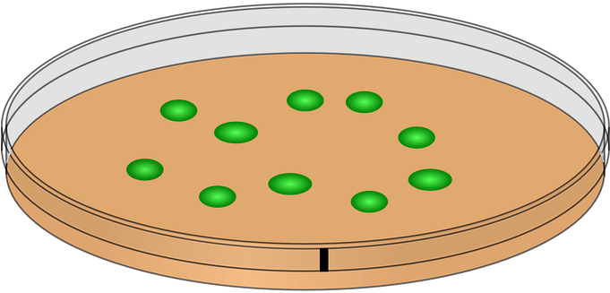

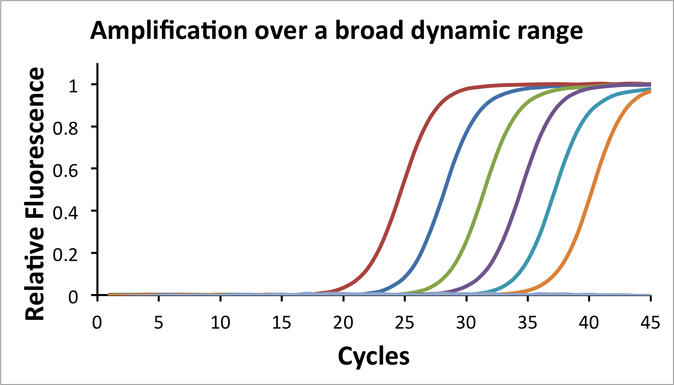

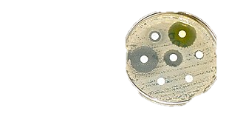
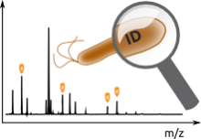
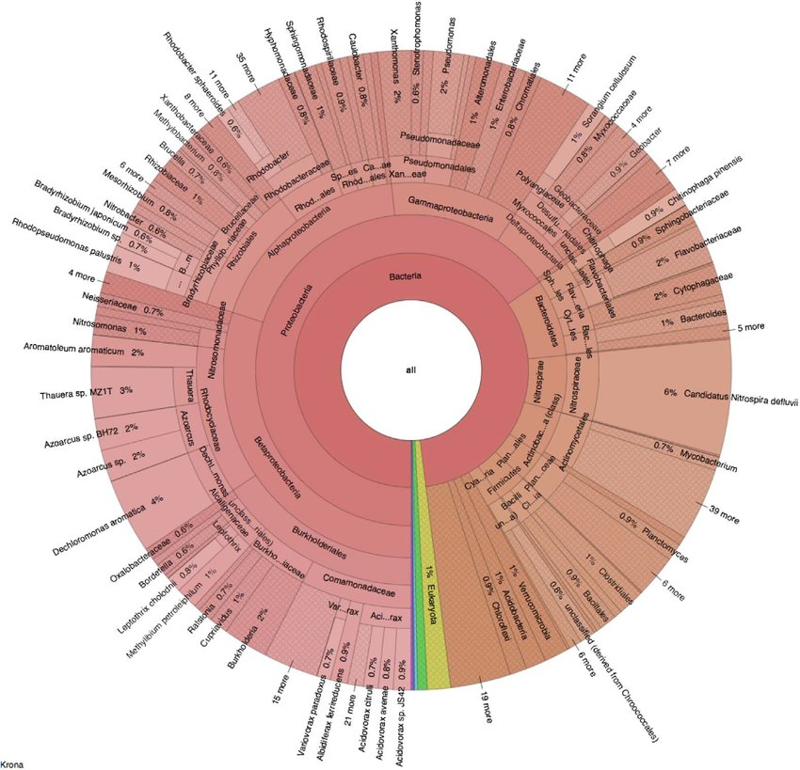
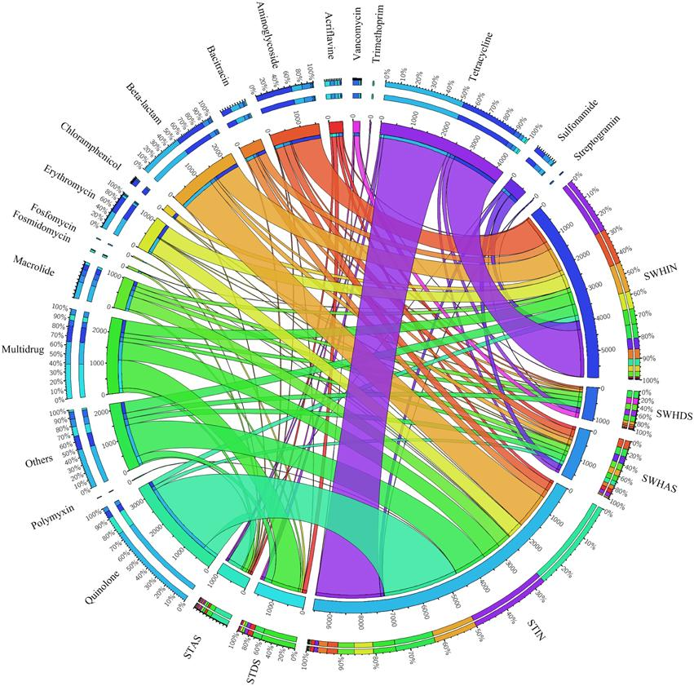
Background - Modern microlab workflow & impact of NGS
Culture dependent
Culture independent
Single gene PCR
24-72h
1h
2-4h
2-4h
24-48h
qPCR / syndromic
Phenotypic testing
MIC Prediction
WGS
Metagenomics
Notes:
WGS - Whole-genome sequencing
Phenotypic testing of mycobacteria - uses number of methods to identify and distinguish mycobacteria species from each other
Metagenomics - study of genetic material recovered directly from environmental samples
qPCR - a technology used for measuring DNA using PCR in real time
PCR - Polymerase Chain Reaction

Slide 5
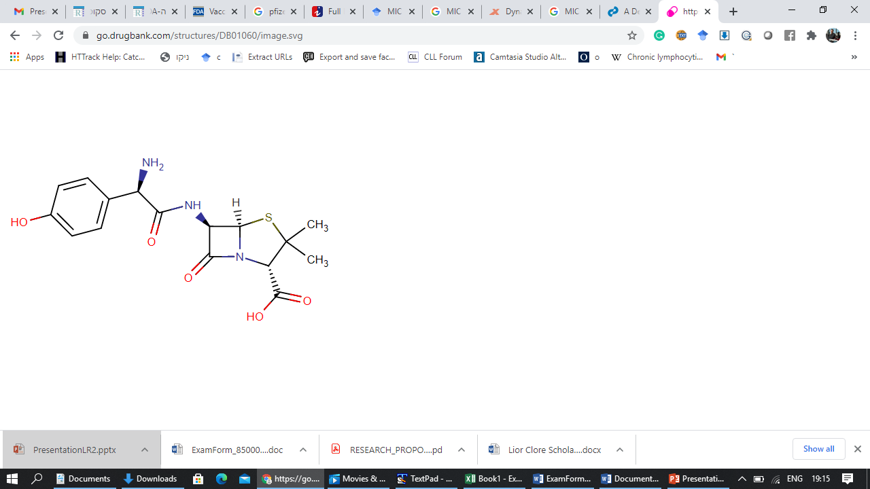





Problem Overview & Motivation
Cheminformatics
Requires extensive up-to-date knowledge
Lack of Systematic Algorithmic Tools – No automated process exists which takes multiple variables under consideration
Long duration of current workflow
Non optimal treatment during process delay
Lack of time and automated tools cause difficulty to evaluate all alternatives and data in a precise manner
Medical Center data
AMR Prediction
Pharmacological Traits
Patient Record Data
Notes:
גל

Slide 6
Project Goal
Development of end-to-end decision-support recommendation system for medical staff
Rule based HRS
Medical Center data
AMR Prediction
Pharmacological Traits
Patient Record Data
Notes:
גל

Slide 7

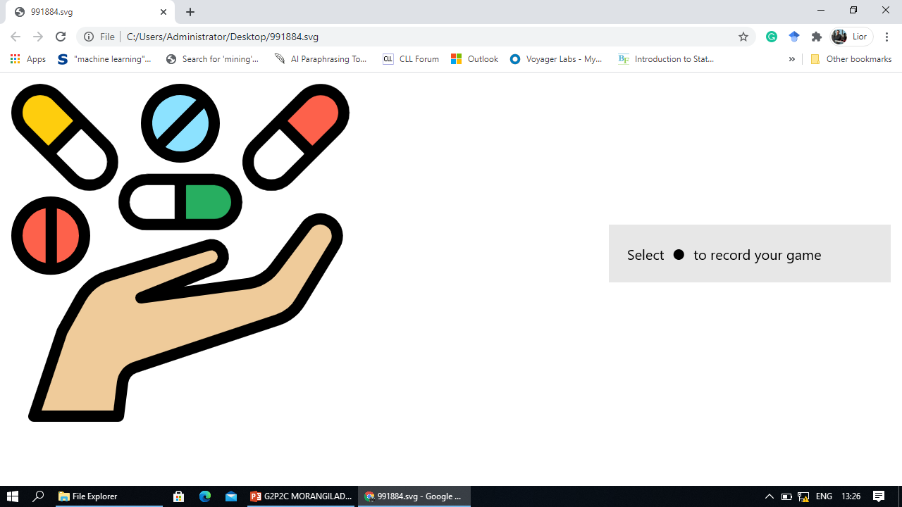


Preliminary Generic Solution - Reminder
Antibiotic Repertoire
Cheminformatics
Pharmacological Traits
NGS
MIC Predictor
Treatment Ranking
Still in Research
Sample
Standard WGS Pipeline
Context-Aware Treatment Recommender
Medical Center data
Patient Record data
Notes:
תומר ק
NGS - Next generation sequencing
MIC - Minimum inhibitory concentration
WGS - Whole-genome sequencing

Slide 8
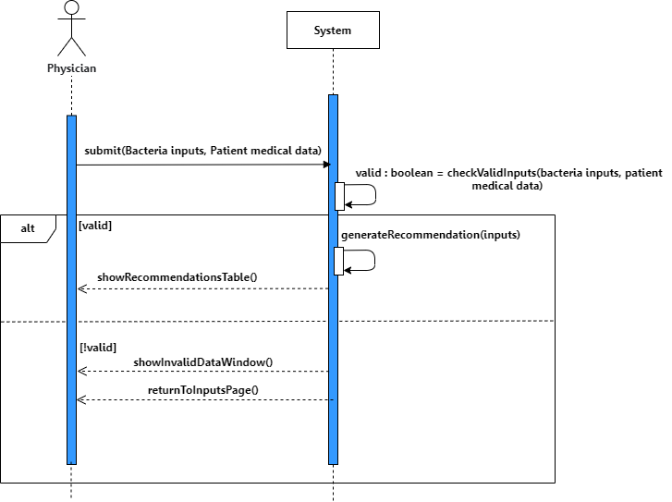
General SSD
Notes:
תומר ק
NGS - Next generation sequencing
MIC - Minimum inhibitory concentration
WGS - Whole-genome sequencing

Slide 9
Systems Review
System | Description & goal | Type | Techniques | Advantages & Disadvantages
Gräße et al. 2017 | Recommending an ideal treatment for patients suffering from psoriasis, based on classic recommendation methos | Data Driven | Collaborative filtering Content base Demographic based Pearson correlation | Neighbors amount improved results inability to provide some recommendations due to scarcity of data cold start problem
Lamy et al 2020 | Explainable decision support through the learning and visualization of preferences | Combined - Data driven and knowledge base | AFB – optimization Problem Ontology – OWL Rainbow boxes | Explainability for medical staff Learning is not fully reproducible binary ranking for treatments – recommended / not recommended
Souissi et al 2019 PARS | Two-stage decision model from evaluation and selection of antibiotics according to effectiveness, categorization according to effectiveness and risk | Knowledge and Rule base | Ontology – OWL Semantic technologies Majority rule sorting | Ability to provide physicians with antibiotic prescription recommendations accompanied by an explanation dividing the alternatives into categories (recommended, possible and desirable to avoid) – no internal ranking

Slide 10
Main Comparison Criteria
Existing Systems | Developed System
Narrowing Down – mostly focused on specific disease or limited number of treatments and decision factors | Scaling Up – easily adjusted and scaled up to support multiple types of bacteria, treatments and decision factors
Data driven - Inability to provide a recommendation for patients that doesn't match existing data | Rule Based - Independence of specific dataset
Low Explainability – most systems didn’t provide justification for chosen treatments | Easily explainable
Mostly Binary\categorical ranking recommendation | Complete internal ranking
Notes:
bacteria \ disease types, optional treatments, decision factors

Slide 11
Our Solution
Single Page Application configuration, Client - Server architecture, Agile method
Rules modeling - medical guidelines for Rule-Based HRS, simulating real decision process, guidance of infectious diseases doctors
Context Aware & Personalized - Adjusted process relying on specific patient
Tailored & Specific – Allows the use of genomic data, removing culture dependency
AMR Prediction - Using bacterium analyzed genetic sequencing data of genotype
Transparency & Explainability - GUI allows to disclose system’s considerations
Notes:
NGS - Next generation sequencing
MIC - Minimum inhibitory concentration
WGS - Whole-genome sequencing

Slide 12
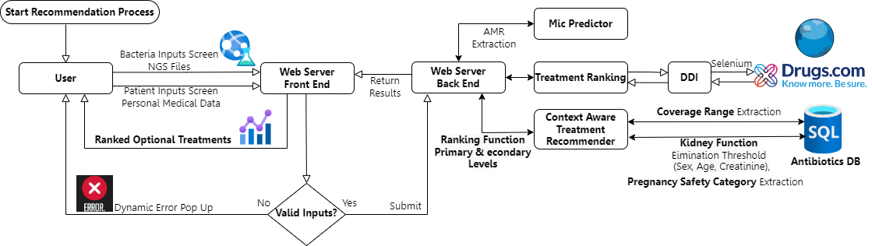
Our Solution System Architecture & Workflow Overview
Server Side – Flask, Client Side – Vue.js
Notes:
תומר ק
NGS - Next generation sequencing
MIC - Minimum inhibitory concentration
WGS - Whole-genome sequencing

Slide 13


Ranking Factors
MIC Level
AMR Of Optional Antibiotics Against The Given Bacteria
Kidney Function
Elimination
DDI
Drug-Drug Interaction With Patient’s Routine Drugs
Elimination Of Antibiotics that Don’t Satisfy Minimum Level Of GFR According Patient’s Data
Range Coverage
Preference Narrow Coverage On Wider Coverage Antibiotics
Pregnancy Category
Preference Safer Antibiotics (US FDA Categories)

Slide 14

System DEMO

Slide 15

System DEMO
Home Page
Notes:
ורון תו

Slide 16
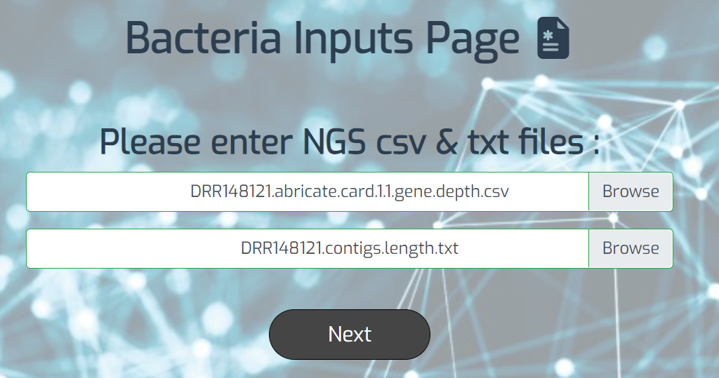
System Inputs
1. Bacteria Inputs Screen
Notes:
ורון תו

Slide 17
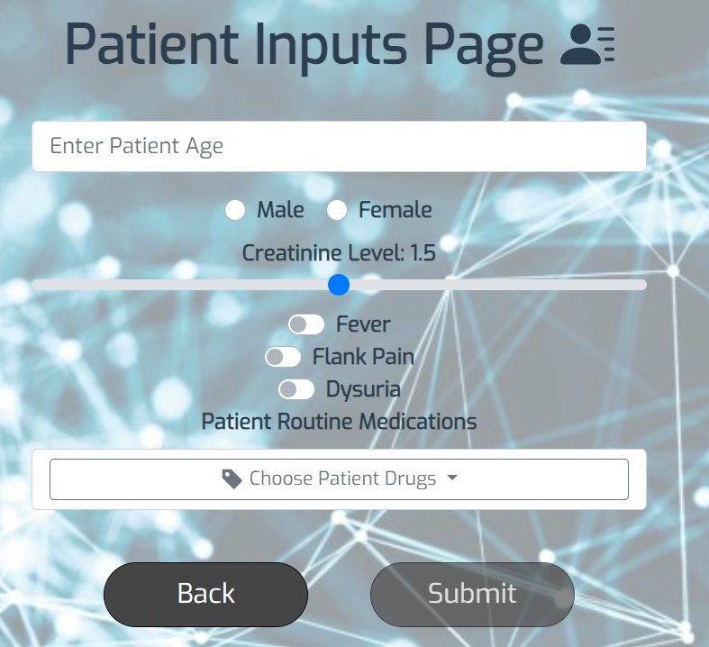
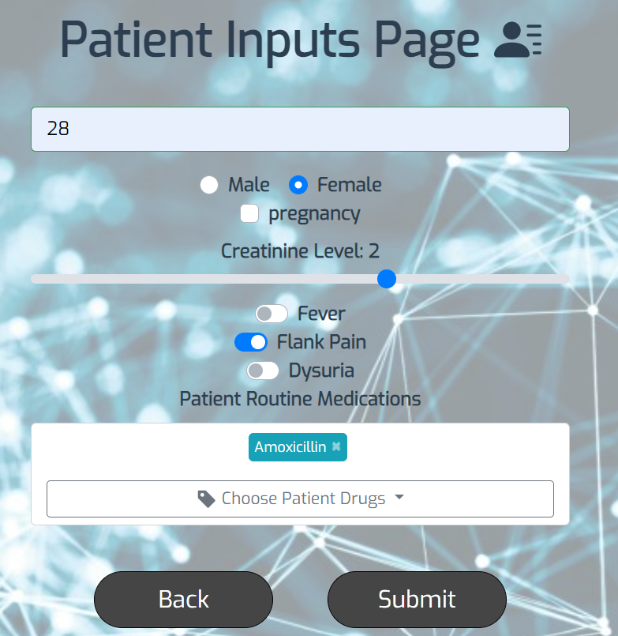
2. Patient Inputs Screen

Slide 18
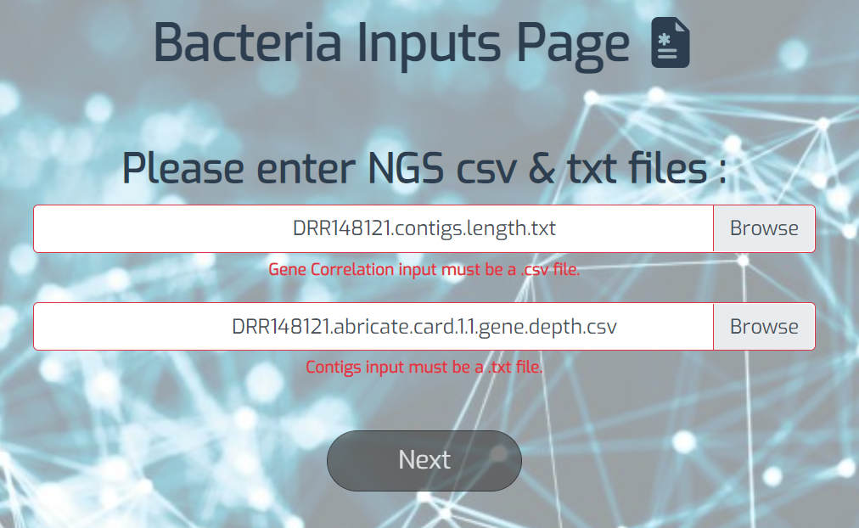
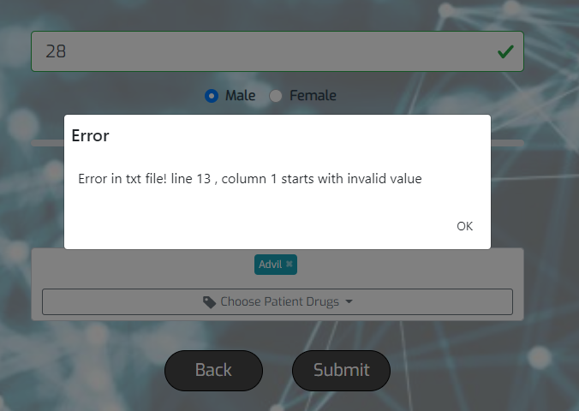
Validation Checks
Notes:
ורון תו

Slide 19
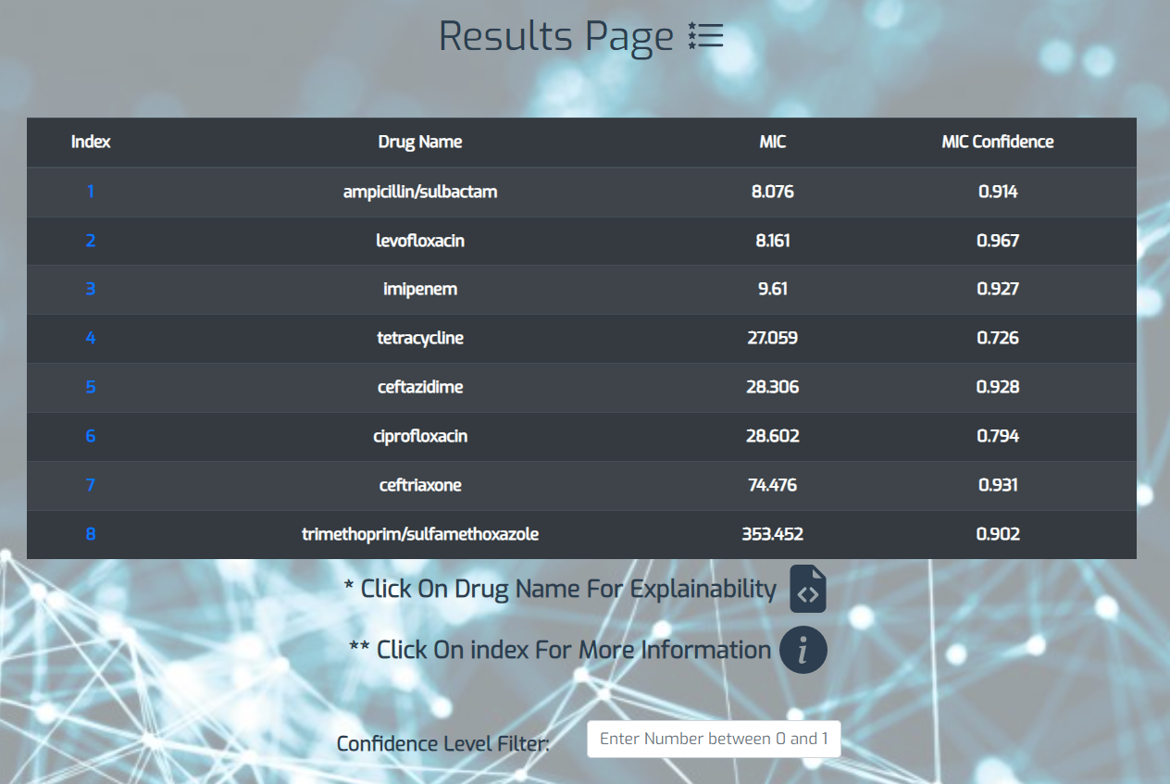
Results Page

Slide 20
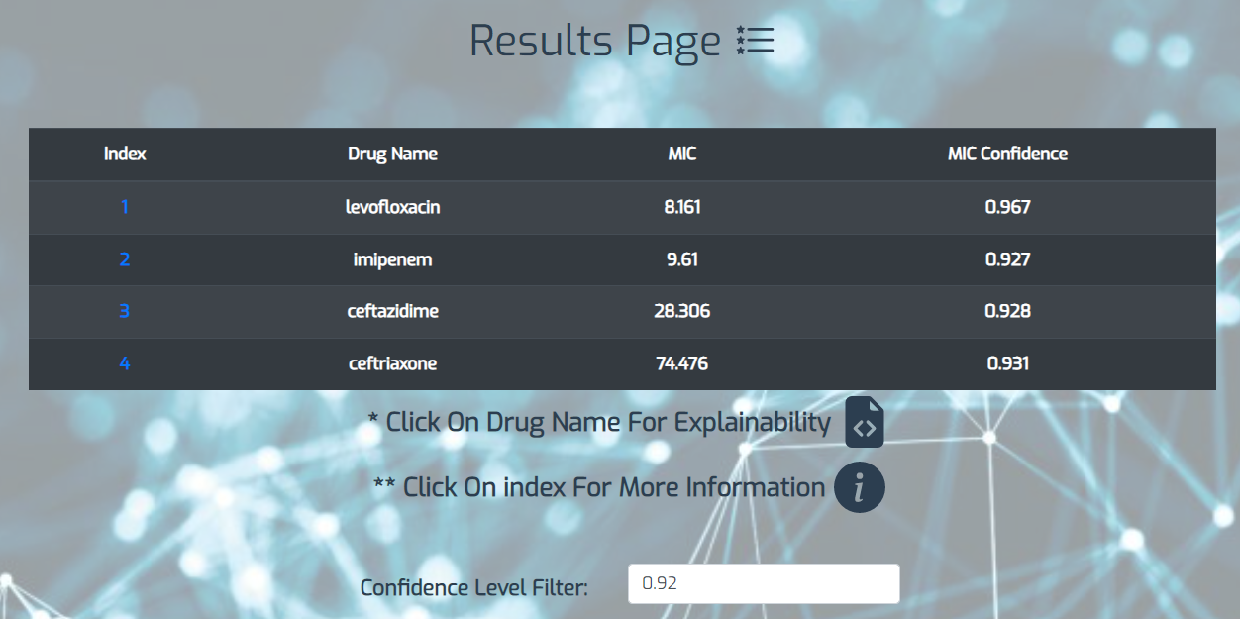
MIC Confidence Level Filter

Slide 21
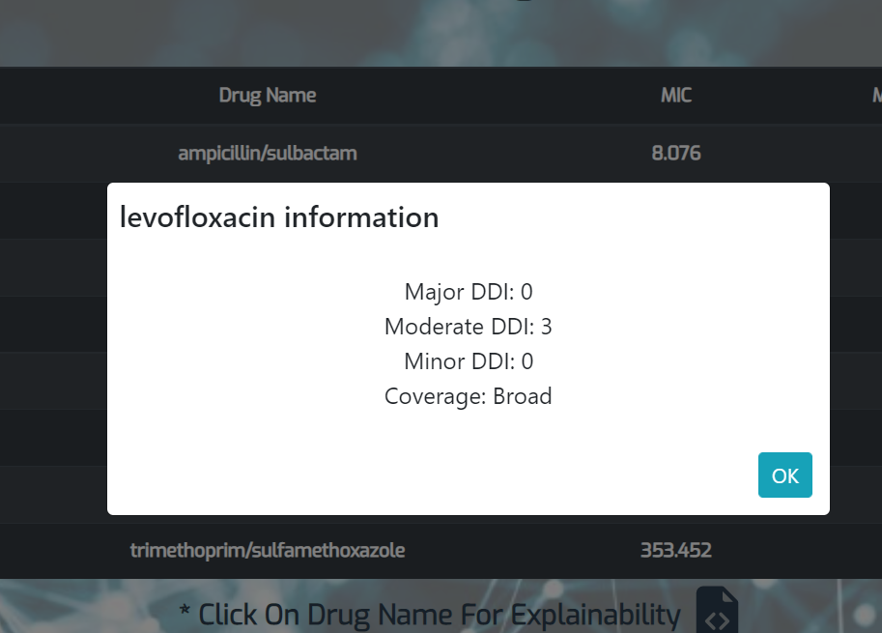
Explainability Feature – Ranking Factors

Slide 22
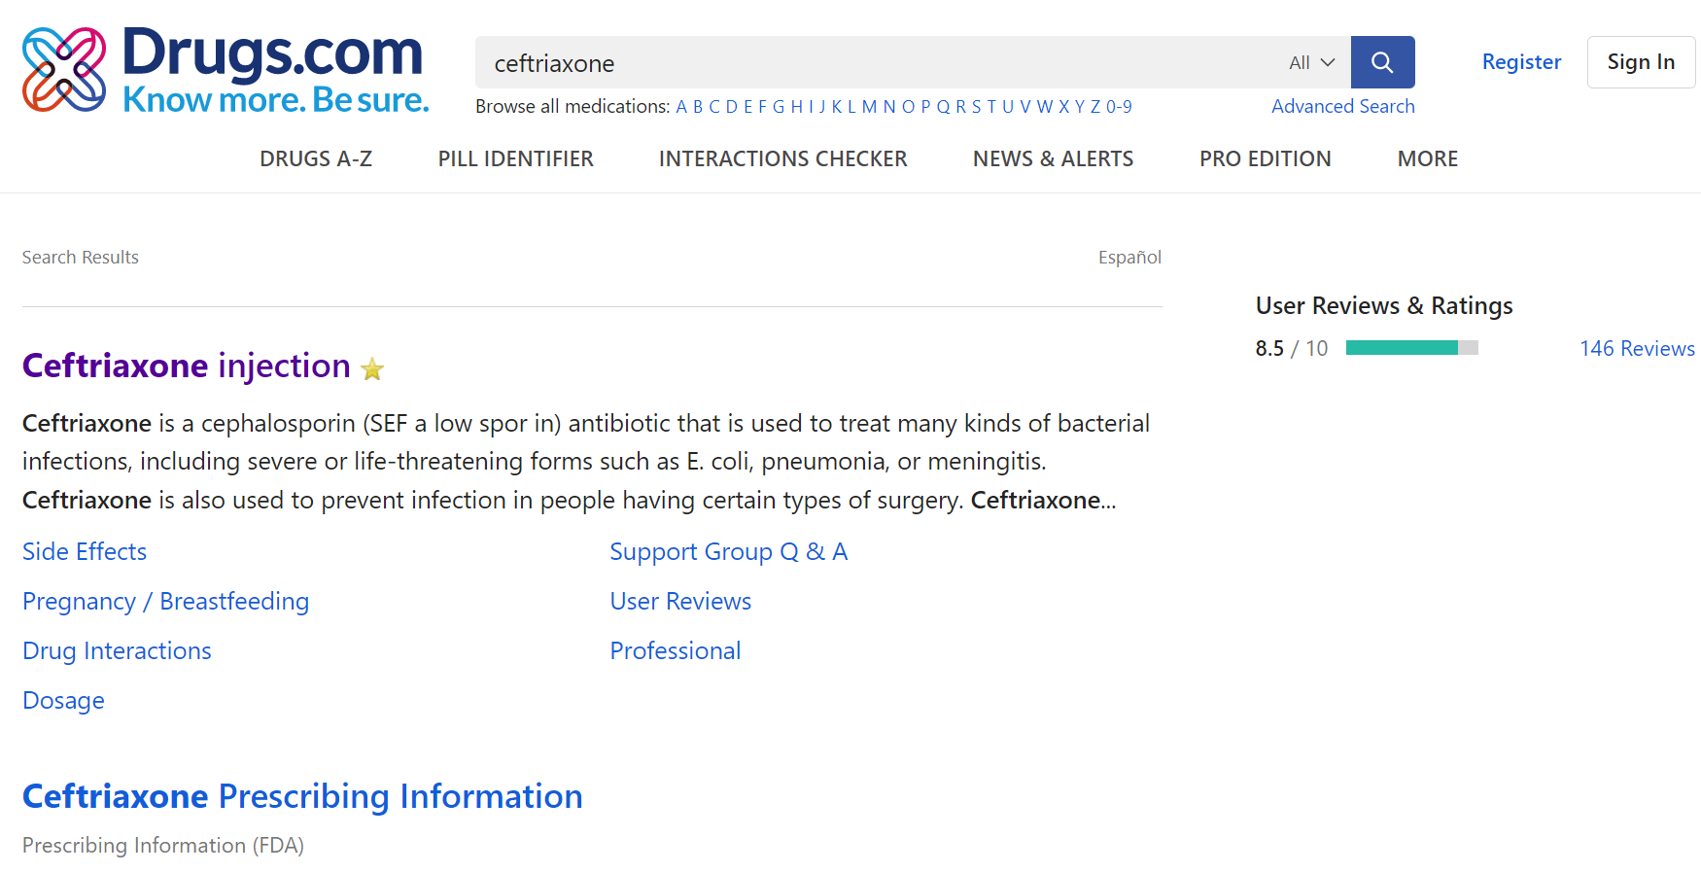
More Information – External URL Routing

Slide 23

Summary & Achievements
Challenges - Understanding biological and medical necessary background, unfamiliar field of study (Medicine\Molecular biology) and technologies
HRS research – Literature Review
Requirements and Use Cases analysis with client
From Scratch - Infrastructure Building for all components
User Friendly, Easy to Use Front End Interface
Runtime Optimization & Efficiency – Offline web scraping of Patients popular drugs using Selenium
Notes:
ורון תו

Slide 24
Discussion & Future Work
Extend antibiotics and bacteria’s possibilities
Extend decision factors – Location of infection, Side effects etc.
Keeping decision factors up-to-date with medical guidelines
Embedding system in hospitals

Slide 25

Questions?

